Slide 1
Lecture 8: ARM Architecture

Slide 2
Why ARM??
STM32 microcontrollers are based on the ARM Cortex-M architecture. The ARM Cortex-M is a family of 32-bit RISC (Reduced Instruction Set Computer) processors that provide a balance between performance, power consumption, and cost-effectiveness

Slide 3
Agenda
What is ARM?
ARM History
ARM IP core
ARM Architecture
Programmers Model
ARM Pipelining
Notes:
Introduction to ARM
Background to who ARM Ltd are, what we do, and how our business model works.
Programmers Model
The structure of the ARM architecture
How it has developed
Register set, modes and exceptions
The endian issue
Instruction Sets
Overview of the features of the ARM instruction set
The coprocessor mechanism
Overview of Thumb - Why it was designed and the benefits it gives.
System Design
Overview of some of the hardware and software technologies that ARM has to support the design in of the ARM core into real products.
Also looks at some of the issues involved with memory maps in ARM based systems.

Slide 4
What is ARM?
ARM : Advanced RISC Machine
ARM will be used for commercial purpose
Applications: Video games controllers, Modems, Mobile phone, Handy cams, etc
Main features: Architectural Simplicity (It allows very small implementations which result is very low power consumption)
History: Developed at ACORN Computer limited (England, 1983 -1985 )

Slide 5

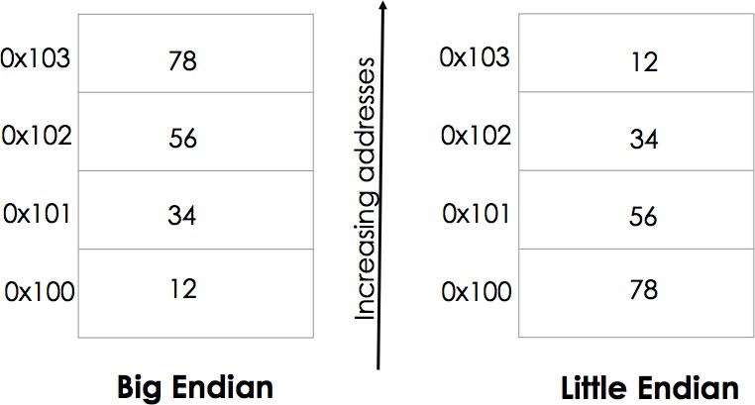
Comp. Arch. Basics: Big Endian vs. Little Endian
How is a word, say, 0x12345678 stored in memory?

Slide 6
Comp. Arch. Basics: Big Endian vs. Little Endian (1)
Big-endian (big end first)
Most significant byte of any multi-byte data field is stored at the lowest memory address
Reading from left to right
SPARC & Motorola
Little-endian (little end first)
Least significant byte of any multi-byte data field is stored at the lowest memory address
Reading from right to left instead
Intel processors
Bi-endian (ARM, PowerPC, Alpha)

Slide 8
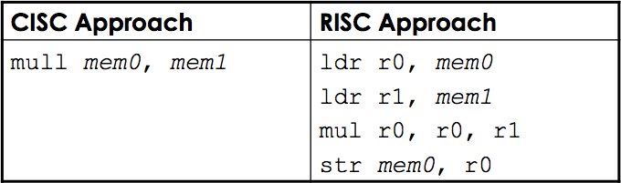
Comp. Arch. Basics: CISC vs. RISC
RISC – Reduced Instruction Set Computers CISC – Complex Instruction Set Computers
Different architectures for doing the same operations
Suppose you wanted to multiply two numbers in memory locations mem0 & mem1 and store the results back in mem0
Same result but the complexity of operations and the number of steps used in the two cases differ

Slide 9
Comp. Arch. Basics: CISC vs. RISC (1)
CISC | RISC
Example – Intel x86 chips | Examples – SPARC, PowerPC, ARM
Large number of instructions | Few instructions, typically less than 100
Variable-length instructions, instructions can range from 1-15 bytes | Fixed-length instructions, all instructions have the same number of bytes
Some instructions can have long execution times | No instruction with a long execution time, typically well balanced
Arithmetic and logical operations can be applied to memory and register operands | Arithmetic and logical operations only use register operands Memory contents have to be loaded into registers first Referred to as load/store architecture
Stack-intensive procedure linkage Stack is used for procedure arguments and return values | Register-intensive procedure linkage Registers used for procedure arguments and return values
Compact code size is typically small | Compiled code size is larger
More transistors = more power | Fewer transistors = less power

Slide 10
Comp. Arch. Basics: Memory Types
DRAM: Dynamic Random-Access Memory
Upside: very dense (1 transistor per bit) and cheap
Downside: requires refresh and often slow
Used as main memory
SRAM: Static Random-Access Memory
Upside: fast and no refresh required
Downside: not so dense, not so cheap
Often used for caches
EEPROM: Electronically Erasable Programmable Read-only Memory
Used for bootstrapping
Require wear-leveling

Slide 11
ARM HISTORY AND
THE ARM PROCESSOR FAMILY

Slide 12
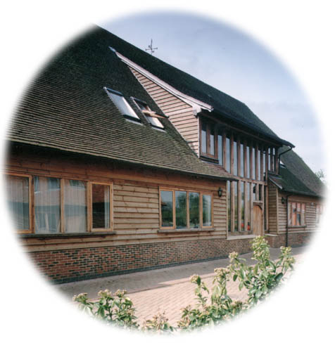
ARM Ltd
Founded in November 1990
Spun out of Acorn Computers
Designs the ARM range of RISC processor cores
Licenses ARM core designs to semiconductor partners who fabricate and sell to their customers.
ARM does not fabricate silicon itself
Also develop technologies to assist with the design-in of the ARM architecture
Software tools, boards, debug hardware, application software, bus architectures, peripherals etc
Notes:
The ARM processor core originates within a British computer company called Acorn. In the mid-1980s they were looking for replacement for the 6502 processor used in their BBC computer range, which were widely used in UK schools. None of the 16-bit architectures becoming available at that time met their requirements, so they designed their own 32-bit processor.
Other companies became interested in this processor, including Apple who were looking for a processor for their PDA project (which became the Newton). After much discussion this led to Acorn’s processor design team splitting off from Acorn at the end of 1990 to become Advanced RISC Machines Ltd, now just ARM Ltd.
Thus ARM Ltd now designs the ARM family of RISC processor cores, together with a range of other supporting technologies.
One important point about ARM is that it does not fabricate silicon itself, but instead just produces the design - we are an Intellectual Property (or IP) company. Instead silicon is produced by companies who license the ARM processor design.

Slide 13
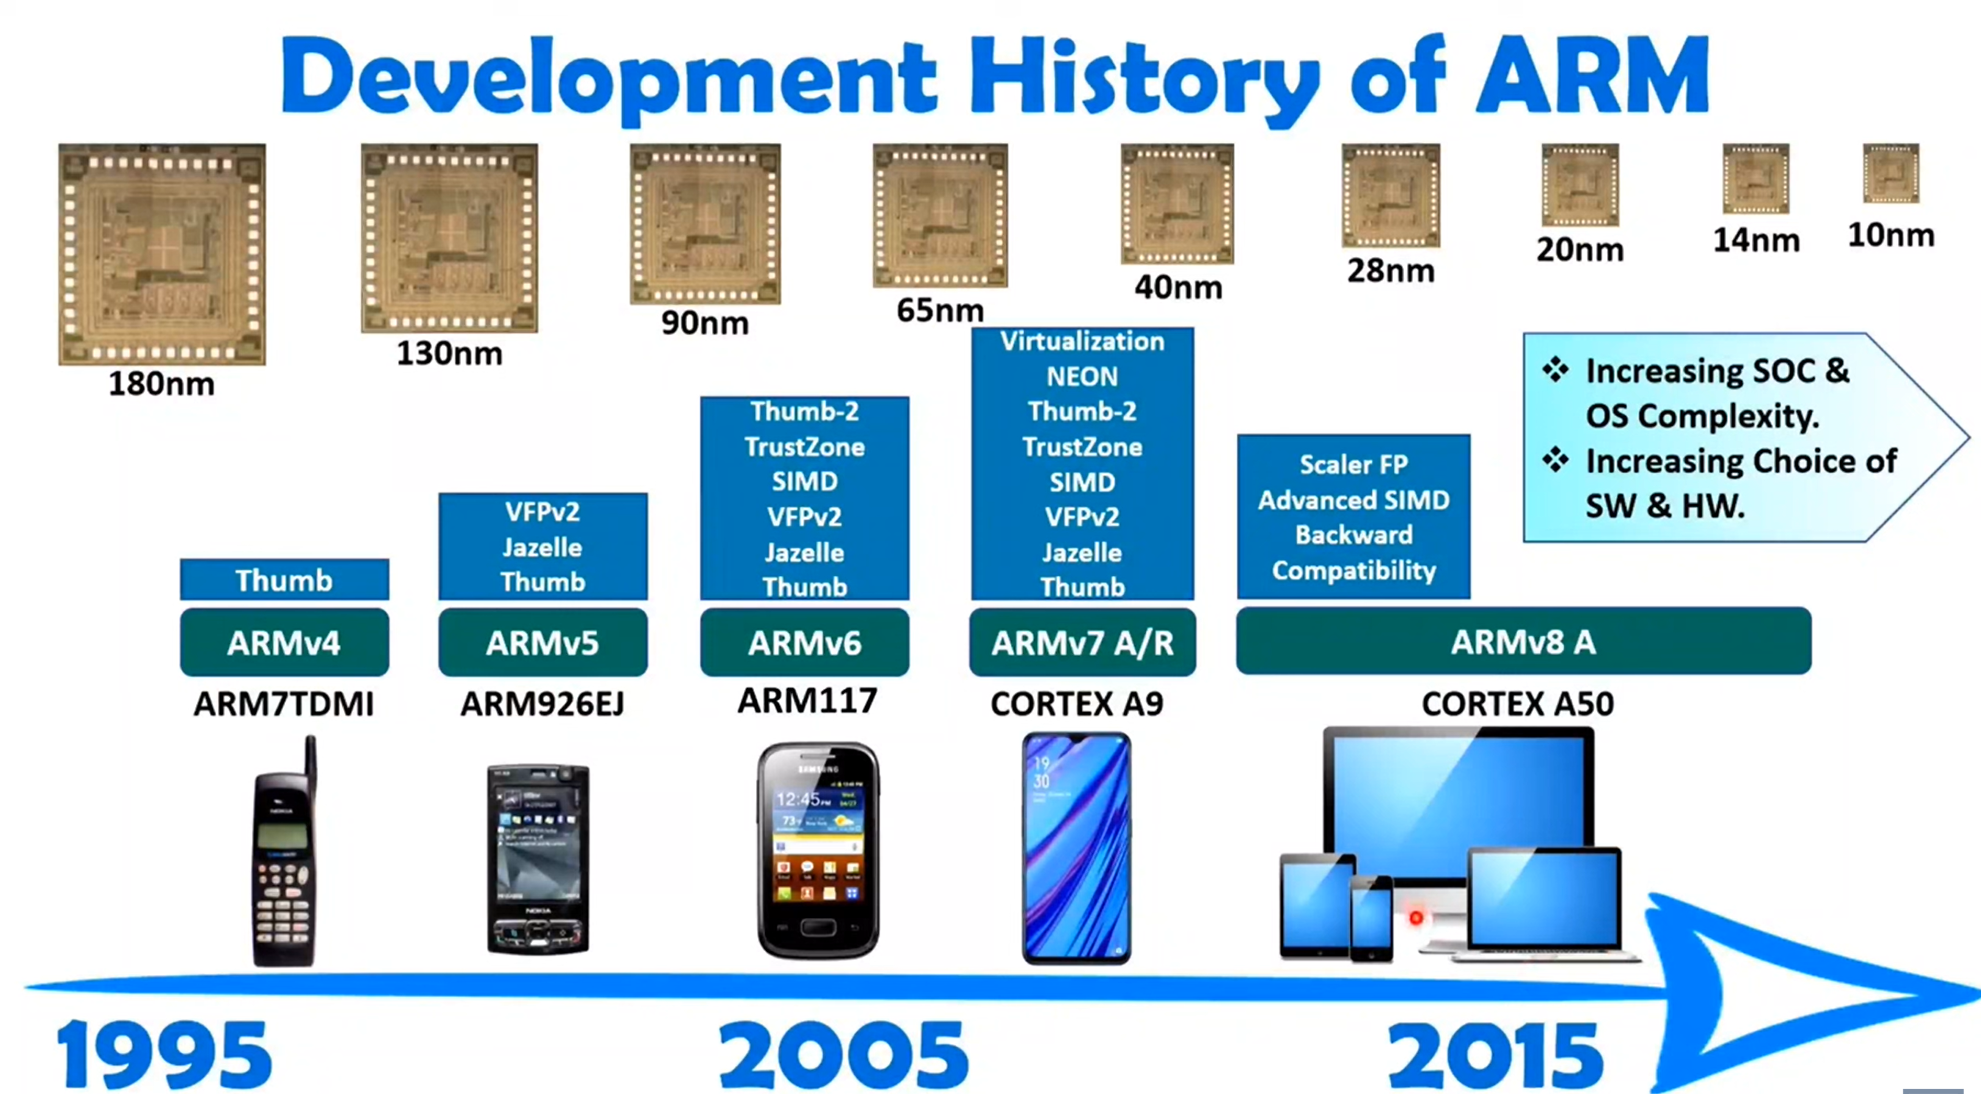
Notes:
SIMD: Single Instruction with Multiple Data
Neon: Instructions based on graphics

Slide 14

ARM Architecture
A family of RISC-based processor architectures
Well-known for its power efficiency; used mostly in mobile devices, such as smartphones and tablets
Most widely used 32-bit instruction-set architecture in terms of volume
6.1 billion ARM processors in 2010 up to 15 billion in 2015
95% of all smartphones, 35% of digital TVs and set-top boxes
ARM Holdings
Spun out of Acorn Computers based in U.K., founded in November 1990
ARM was originally Acorn RISC Machines
Does not manufacture chips, but licences the design to companies (licensees) such as: Apple, Freescale, Nintendo, Xilinx, Qualcomm, Ti,…
Also develops technologies to help with the design-in of ARM devices, software tools, boards, debug hardware, application software, buses, peripherals

Slide 15


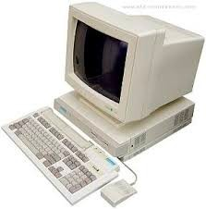

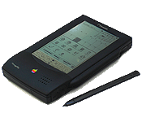

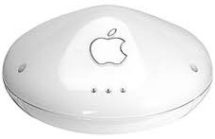

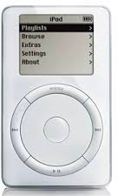



History of ARM’s Usage¹
Acorn Archimedes (ARM 2)
Palm Pre, iPhone 3Gs, Samsung Galaxy S, lots more (Cortex-A8)
Apple Newton (ARM 6)
Nokia NGage, Airport Extreme N (ARM 9E)
ARM 1
Today: ARM Everywhere (next slide)
1985
1990
1995
2000
2005
2010
Game Boy Advance, Nintendo DS, iPod (ARM 7TDMI)
iPhone, iPhone 3G, iPod Touch (ARM 11)
¹Approximate product release dates

Slide 16

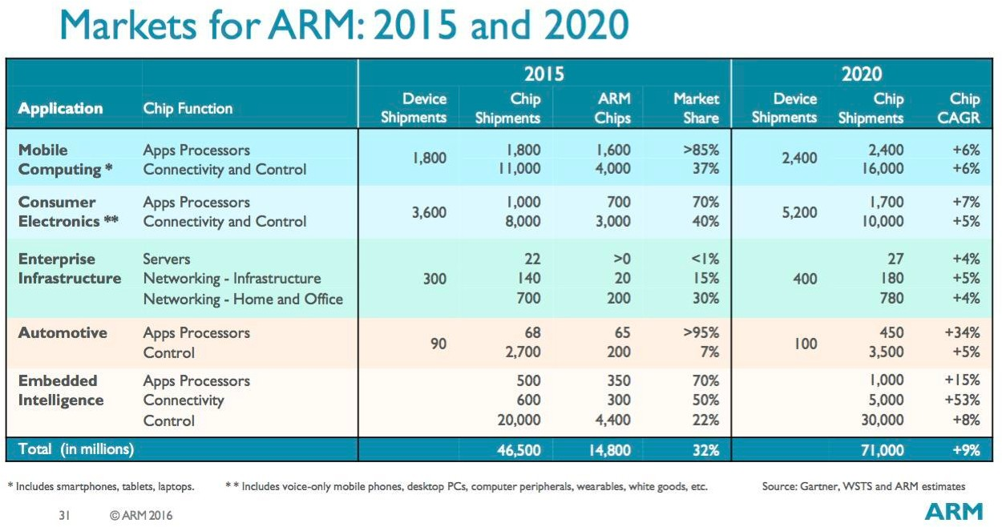

ARM Everywhere

Slide 17

ARM Powered Products

Slide 18
Intellectual Property
ARM provides hard and soft views to licences
RTL and synthesis flows
GDSII layout
Licences have the right to use hard or soft views of the IP
soft views include gate level netlists
hard views are DSMs
OEMs must use hard views
to protect ARM IP

Slide 19
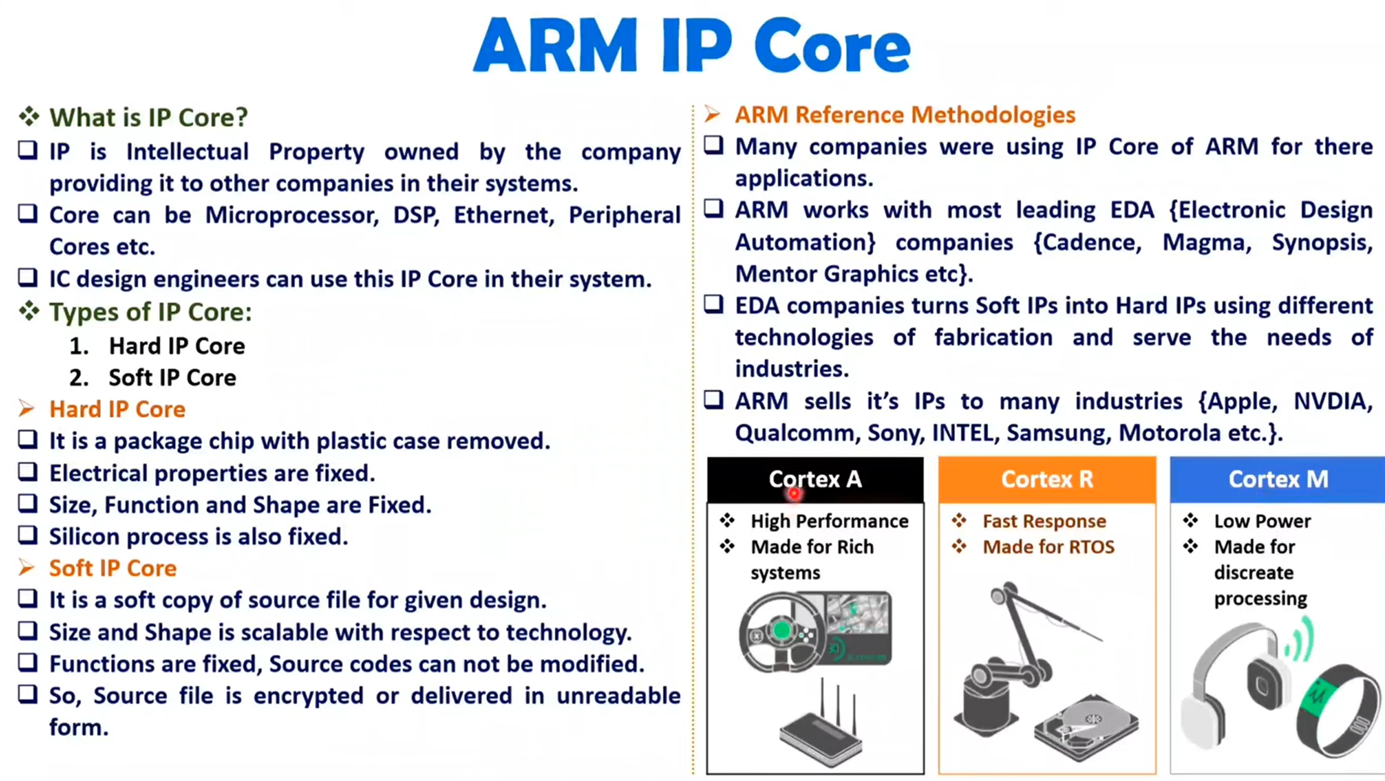


Slide 20

ARM Partnership Model
Notes:
ARM’s business model centres around the principle of partnership. At the centre of this are ARM’s semiconductor partners who design, manufacture and market ARM-compliant products.
Having so many partner companies producing silicon executing the same instruction set is a very important part of ARM’s strength in the market place.
However each of our semiconductor partners bring their own unique strengths to the partnership - each having their own technologies, applications knowledge, product focus, culture, geography, and key customers.
In addition to our partnering with semiconductor companies, we also partner with a large number of other third parties to ensure that operating systems, EDA and software development tools, application software and design services are available for doing ARM based designs.
“ATAP” stands for ARM Technology Access Program. Creates a network of independent design service companies and equips them to deliver ARM-powered designs. Members get access to ARM technology, expertise and support. Members sometimes referred to as “Approved Design Centers”.

Slide 21
ARM Architecture

Slide 22
ARM Architecture
ARM is a 32-bit Architecture
Fixed length instructions
Pipelines
Load/store Architecture
Most ARM implements 2 instruction sets
-32 bits ARM instruction set
-16 bits thumb instruction set
Jazele instruction set used for the concepts that are implemented using JAVA

Slide 23
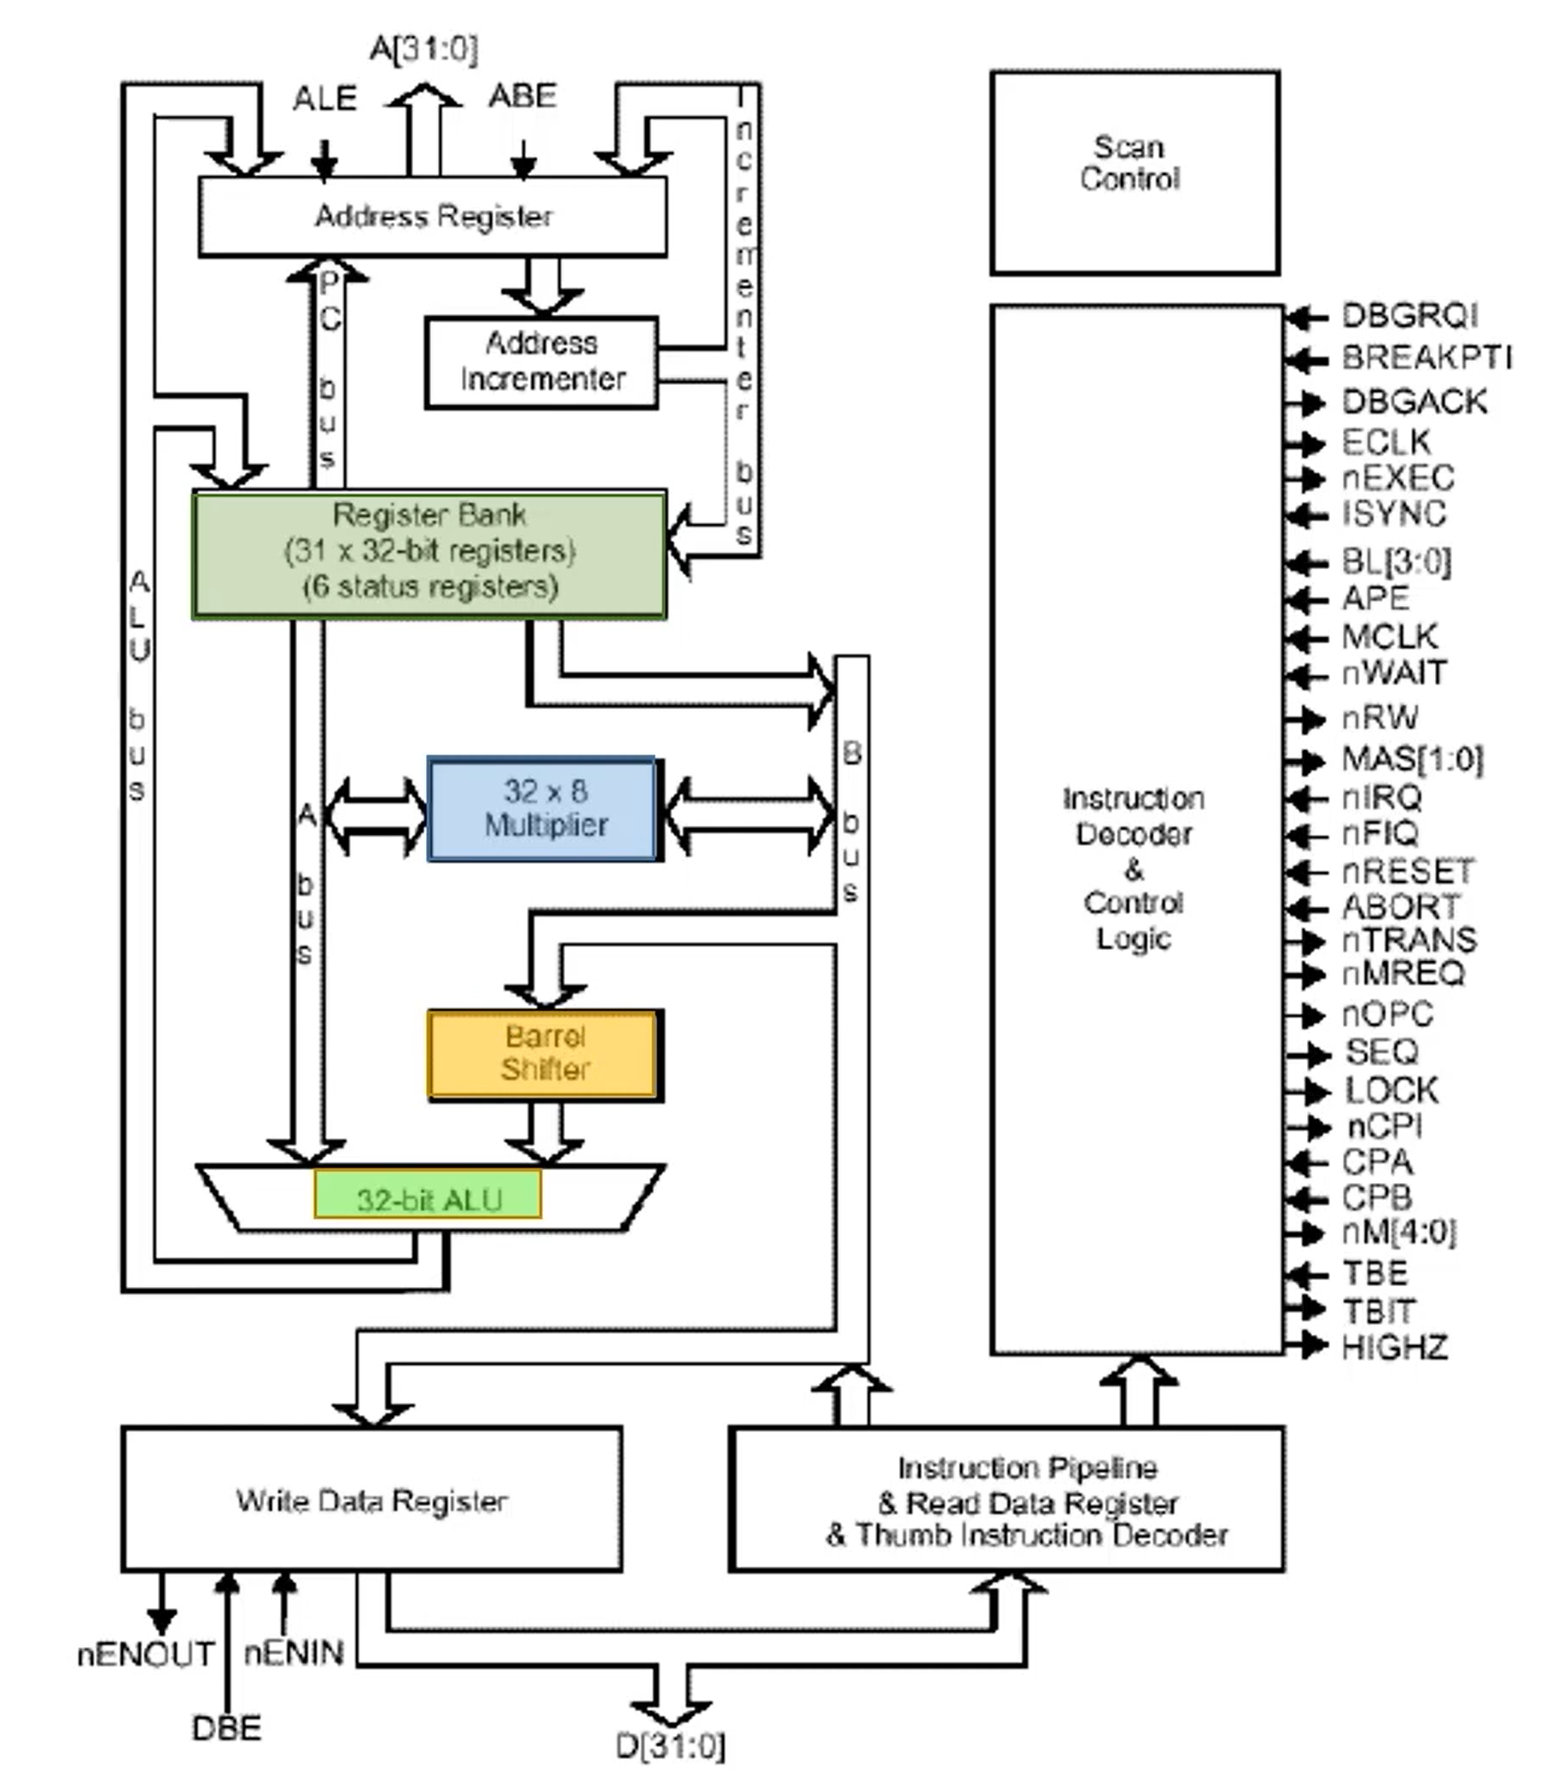

Slide 24
Inside an ARM-based system
ARM processor core
CoreLink interrupt controller
Two buses:
High performance system bus AMBA AXI
Low power peripheral called APB
AXI is used to connect memories and other high-speed devices.
APB is used to connect all peripherals
Development of the ARM Architecture:
v4T -→ARM7TDMI-S
v5TE -→ ARM926J-S
v6 -→ ARM II35J(F)-S
v7-→ Cortex

Slide 25
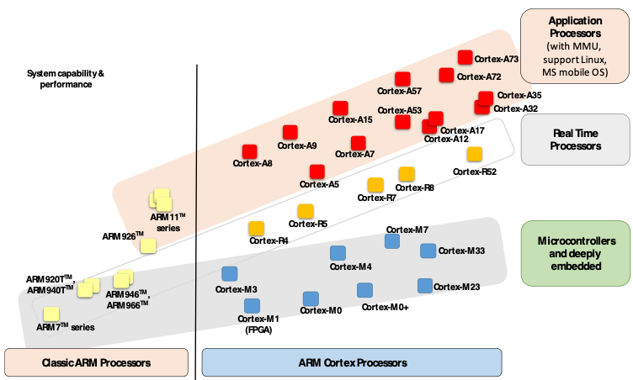

ARM Processor Families
High performance processors capable of full Operating System (OS) support;
Applications include smartphones, digital TV, smart books, home gateways etc.
High performance for real-time applications;
High reliability
Applications include automotive braking system, powertrains etc.
Cost-sensitive solutions for deterministic microcontroller applications;
Applications include microcontrollers, mixed signal devices, smart sensors, automotive body electronics and airbags;
As of Dec 2013

Slide 26
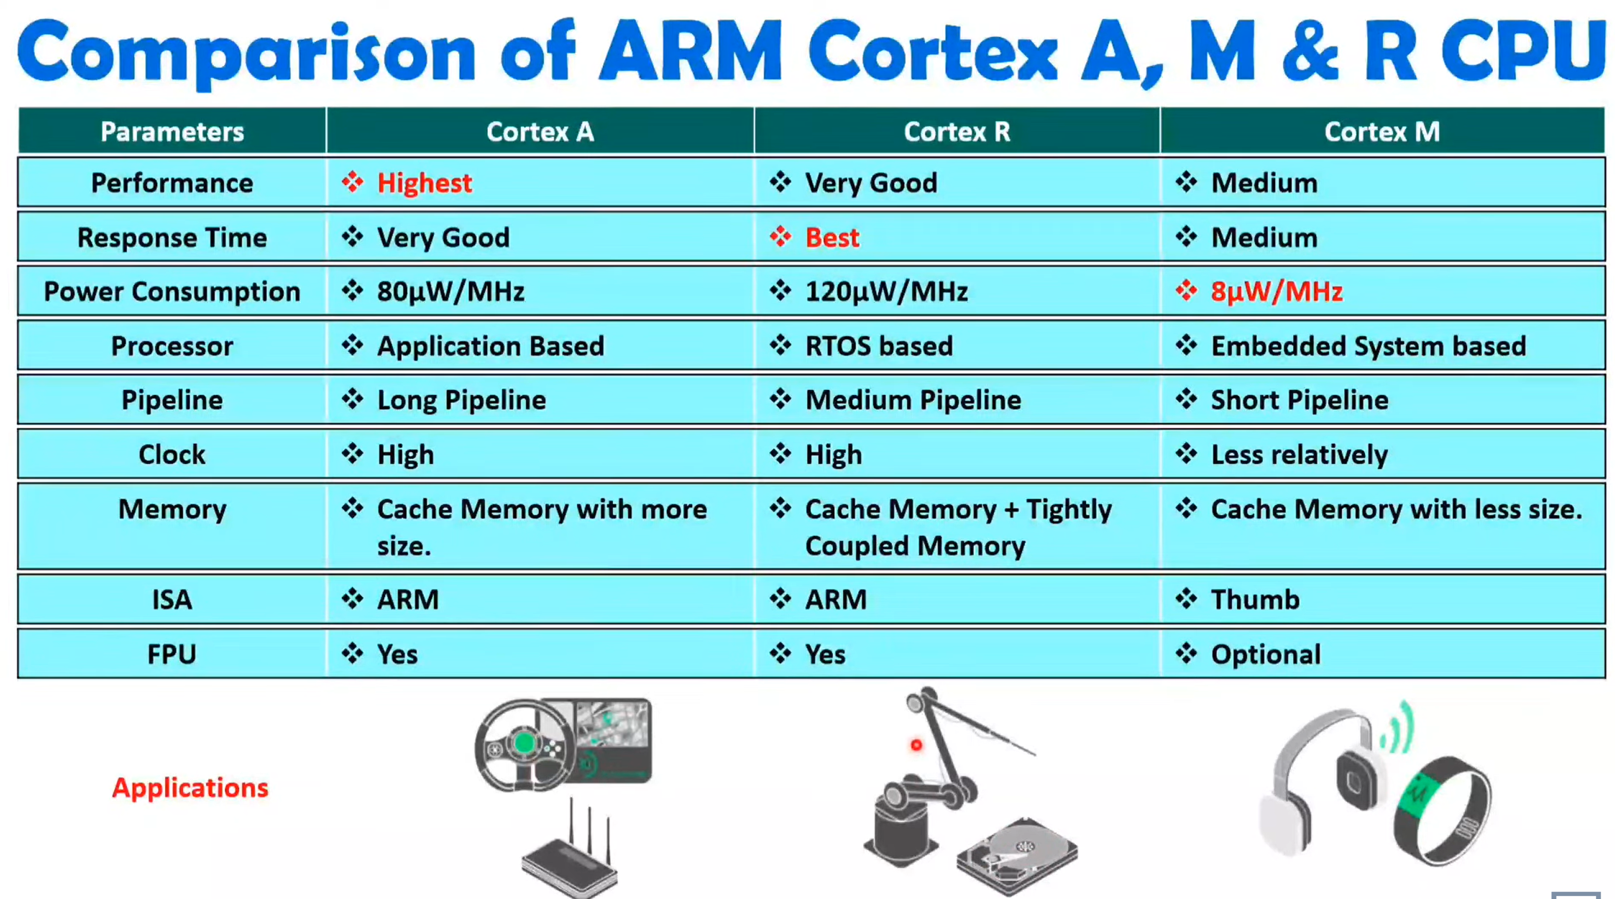

Slide 27
ARM Programmers Model

Slide 28
Data Sizes and Instruction Sets
The ARM is a 32-bit architecture.
When used in relation to the ARM:
Byte means 8 bits
Halfword means 16 bits (two bytes)
Word means 32 bits (four bytes)
Most ARM’s implement two instruction sets
32-bit ARM Instruction Set
16-bit Thumb Instruction Set
Jazele cores can also execute Java bytecode
Notes:
The cause of confusion here is the term “word” which will mean 16-bits to people with a 16-bit background.
In the ARM world 16-bits is a “halfword” as the architecture is a 32-bit one, whereas “word” means 32-bits.
Java bytecodes are 8-bit instructions designed to be architecture independent. Jazelle transparently executes most bytecodes in hardware and some in highly optimized ARM code. This is due to a tradeoff between hardware complexity (power consumption & silicon area) and speed.

Slide 29
Processor Modes
The ARM has seven basic operating modes:
User : unprivileged mode under which most tasks run
FIQ : entered when a high priority (fast) interrupt is raised
IRQ : entered when a low priority (normal) interrupt is raised
Supervisor : entered on reset and when a Software Interrupt
instruction is executed
Abort : used to handle memory access violations
Undef :used to handle undefined instructions
System : privileged mode using the same registers as user mode
Notes:
The Programmers Model can be split into two elements - first of all, the processor modes and secondly, the processor registers. So let’s start by looking at the modes.
Now the typical application will run in an unprivileged mode know as “User” mode, whereas the various exception types will be dealt with in one of the privileged modes : Fast Interrupt, Supervisor, Abort, Normal Interrupt and Undefined (and we will look at what causes each of the exceptions later on).
NB - spell out the word FIQ, otherwise you are saying something rude in German!
One question here is what is the difference between the privileged and unprivileged modes? Well in reality very little really - the ARM core has an output signal (nTRANS on ARM7TDMI, InTRANS, DnTRANS on 9, or encoded as part of HPROT or BPROT in AMBA) which indicates whether the current mode is privileged or unprivileged, and this can be used, for instance, by a memory controller to only allow IO access in a privileged mode. In addition some operations are only permitted in a privileged mode, such as directly changing the mode and enabling of interrupts.
All current ARM cores implement system mode (added in architecture v4). This is simply a privileged version of user mode. Important for re-entrant exceptions because no exceptions can cause system mode to be entered.

Slide 30
The ARM Register Set
Current Visible Registers
Current Visible Registers
Current Visible Registers
Current Visible Registers
Current Visible Registers
Current Visible Registers
r0
r0
r0
r0
r0
r0
Abort Mode
r0
SVC Mode
Undef Mode
FIQ Mode
User Mode
IRQ Mode
r1
r1
r1
r1
r1
r1
r1
r2
r2
r2
r2
r2
r2
r2
Banked out Registers
Banked out Registers
Banked out Registers
Banked out Registers
Banked out Registers
r3
Banked out Registers
r3
r3
r3
r3
r3
r3
r4
r4
r4
r4
r4
r4
r4
r5
r5
r5
r5
r5
r5
r5
User
User
User
User
User
FIQ
FIQ
FIQ
FIQ
FIQ
FIQ
IRQ
IRQ
IRQ
IRQ
IRQ
IRQ
SVC
SVC
SVC
SVC
SVC
SVC
Undef
Undef
Undef
Undef
Undef
Undef
Abort
Abort
Abort
Abort
Abort
r6
Abort
r6
r6
r6
r6
r6
r6
r7
r7
r7
r7
r7
r7
r7
r8
r8
r8
r8
r8
r8
r8
r8
r8
r8
r8
r8
r8
r8
r9
r9
r9
r9
r9
r9
r9
r9
r9
r9
r9
r9
r9
r9
r10
r10
r10
r10
r10
r10
r10
r10
r10
r10
r10
r10
r10
r10
r11
r11
r11
r11
r11
r11
r11
r11
r11
r11
r11
r11
r11
r11
r12
r12
r12
r12
r12
r12
r12
r12
r12
r12
r12
r12
r12
r12
r13 (sp)
r13 (sp)
r13 (sp)
r13 (sp)
r13 (sp)
r13 (sp)
r13 (sp)
r13 (sp)
r13 (sp)
r13 (sp)
r13 (sp)
r13 (sp)
r13 (sp)
r13 (sp)
r13 (sp)
r13 (sp)
r13 (sp)
r13 (sp)
r13 (sp)
r13 (sp)
r13 (sp)
r13 (sp)
r13 (sp)
r13 (sp)
r13 (sp)
r13 (sp)
r13 (sp)
r13 (sp)
r13 (sp)
r13 (sp)
r13 (sp)
r13 (sp)
r13 (sp)
r13 (sp)
r13 (sp)
r13 (sp)
r13 (sp)
r13 (sp)
r13 (sp)
r13 (sp)
r13 (sp)
r13 (sp)
r14 (lr)
r14 (lr)
r14 (lr)
r14 (lr)
r14 (lr)
r14 (lr)
r14 (lr)
r14 (lr)
r14 (lr)
r14 (lr)
r14 (lr)
r14 (lr)
r14 (lr)
r14 (lr)
r14 (lr)
r14 (lr)
r14 (lr)
r14 (lr)
r14 (lr)
r14 (lr)
r14 (lr)
r14 (lr)
r14 (lr)
r14 (lr)
r14 (lr)
r14 (lr)
r14 (lr)
r14 (lr)
r14 (lr)
r14 (lr)
r14 (lr)
r14 (lr)
r14 (lr)
r14 (lr)
r14 (lr)
r14 (lr)
r14 (lr)
r14 (lr)
r14 (lr)
r14 (lr)
r14 (lr)
r14 (lr)
r15 (pc)
r15 (pc)
r15 (pc)
r15 (pc)
r15 (pc)
r15 (pc)
r15 (pc)
cpsr
cpsr
cpsr
cpsr
cpsr
cpsr
cpsr
spsr
spsr
spsr
spsr
spsr
spsr
spsr
spsr
spsr
spsr
spsr
spsr
spsr
spsr
spsr
spsr
spsr
spsr
spsr
spsr
spsr
spsr
spsr
spsr
spsr
spsr
spsr
spsr
spsr
spsr
spsr
spsr
spsr
spsr
spsr
Notes:
This animated slide shows the way that the banking of registers works. On the left the currently visible set of registers are shown for a particular mode.
On the right are the registers that are banked out whilst in that mode.
Each key press will switch mode:
user -> FIQ ->user -> IRQ -> user ->SVC -> User -> Undef -> User -> Abort and then back to user.
The following slide then shows this in a more static way that is more useful for reference

Slide 31
The Registers
ARM has 37 registers all of which are 32-bits long.
1 dedicated program counter
1 dedicated current program status register
5 dedicated saved program status registers
30 general purpose registers
The current processor mode governs which of several banks is accessible. Each mode can access
a particular set of r0-r12 registers
a particular r13 (the stack pointer, sp) and r14 (the link register, lr) the program counter, r15 (pc)the current program status register ( cpsr )
Privileged modes (except System) can also access
a particular spsr (saved program status register)
Notes:
The ARM architecture provides a total of 37 registers, all of which are 32-bits long. However these are arranged into several banks, with the accessible bank being governed by the current processor mode. We will see this in more detail in a couple of slides. In summary though, in each mode, the core can access:
a particular set of 13 general purpose registers (r0 - r12).
a particular r13 - which is typically used as a stack pointer. This will be a different r13 for each mode, so allowing each exception type to have its own stack.
a particular r14 - which is used as a link (or return address) register. Again this will be a different r14 for each mode.
r15 - whose only use is as the Program counter.
The CPSR (Current Program Status Register) - this stores additional information about the state of the processor:
And finally in privileged modes, a particular SPSR (Saved Program Status Register). This stores a copy of the previous CPSR value when an exception occurs. This combined with the link register allows exceptions to return without corrupting processor state.

Slide 32
Register Organization Summary
User
FIQ
IRQ
SVC
Undef
Abort
r0
User mode r0-r7, r15, and cpsr
User mode r0-r12, r15, and cpsr
User mode r0-r12, r15, and cpsr
User mode r0-r12, r15, and cpsr
User mode r0-r12, r15, and cpsr
r1
r2
r3
r4
Thumb state
Low registers
r5
r6
r7
r8
r8
r9
r9
r10
r10
Thumb state
High registers
r11
r11
r12
r12
r13 (sp)
r13 (sp)
r13 (sp)
r13 (sp)
r13 (sp)
r13 (sp)
r14 (lr)
r14 (lr)
r14 (lr)
r14 (lr)
r14 (lr)
r14 (lr)
r15 (pc)
cpsr
spsr
spsr
spsr
spsr
spsr
Note: System mode uses the User mode register set
Notes:
This slide shows the registers visible in each mode - basically in a more static fashion than the previous animated slide that is more useful for reference.
The main point to state here is the splitting of the registers in Thumb state into Low and High registers.
ARM register banking is the minimum necessary for fast handling of overlapping exceptions of different types (e.g. ABORT during SWI during IRQ). For nested exceptions of the same type (e.g. re-entrant interrupts) some additional pushing of registers to the stack is required.

Slide 33
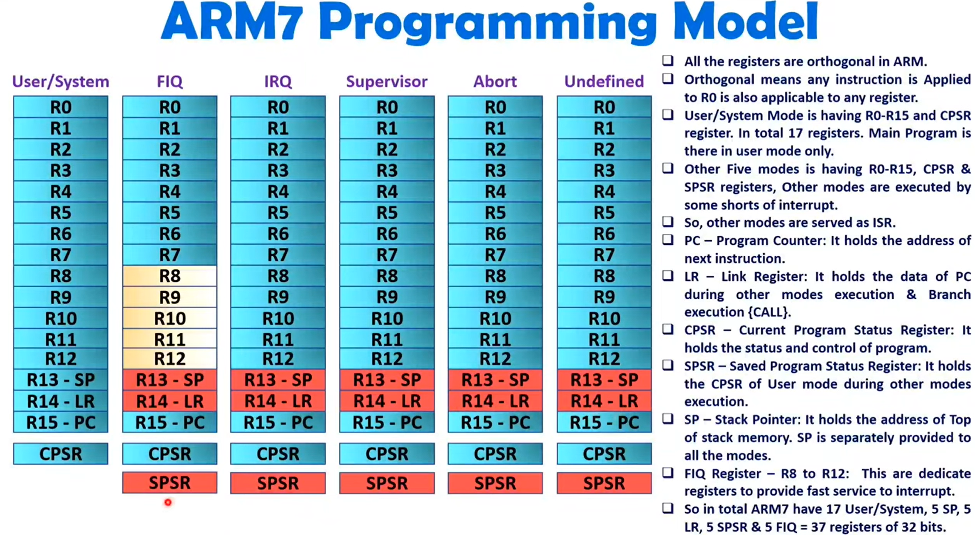

Slide 34
Program Status Registers
31
28
27
24
23
16
15
8
7
6
5
4
0
N Z C V Q
U n d e f i n e d
I F T mode
J
f
s
x
c
Condition code flags
N = Negative result from ALU
Z = Zero result from ALU
C = ALU operation Carried out
V = ALU operation oVerflowed
Sticky Overflow flag - Q flag
Architecture 5TE/J only
Indicates if saturation has occurred
J bit
Architecture 5TEJ only
J = 1: Processor in Jazelle state
Interrupt Disable bits.
I = 1: Disables the IRQ.
F = 1: Disables the FIQ.
T Bit
Architecture xT only
T = 0: Processor in ARM state
T = 1: Processor in Thumb state
Mode bits
Specify the processor mode
Notes:
Green psr bits are only in certain versions of the ARM architecture
ALU status flags (set if "S" bit set, implied in Thumb state).
Sticky overflow flag (Q flag) is set either when
saturation occurs during QADD, QDADD, QSUB or QDSUB, or
the result of SMLAxy or SMLAWx overflows 32-bits
Once flag has been set can not be modified by one of the above instructions and must write to CPSR using MSR instruction to cleared
PSRs split into four 8-bit fields that can be individually written:
Control (c) bits 0-7
Extension (x) bits 8-15 Reserved for future use
Status (s) bits 16-23 Reserved for future use
Flags (f) bits 24-31
Bits that are reserved for future use should not be modified by current software. Typically, a read-modify-write strategy should be used to update the value of a status register to ensure future compatibility. Note that the T/J bits in the CPSR should never be changed directly by writing to the PSR (use the BX/BXJ instruction to change state instead).
However, in cases where the processor state is known in advance (e.g. on reset, following an interrupt, or some other exception), an immediate value may be written directly into the status registers, to change only specific bits (e.g. to change mode).
New ARM V6 bits now shown.

Slide 35
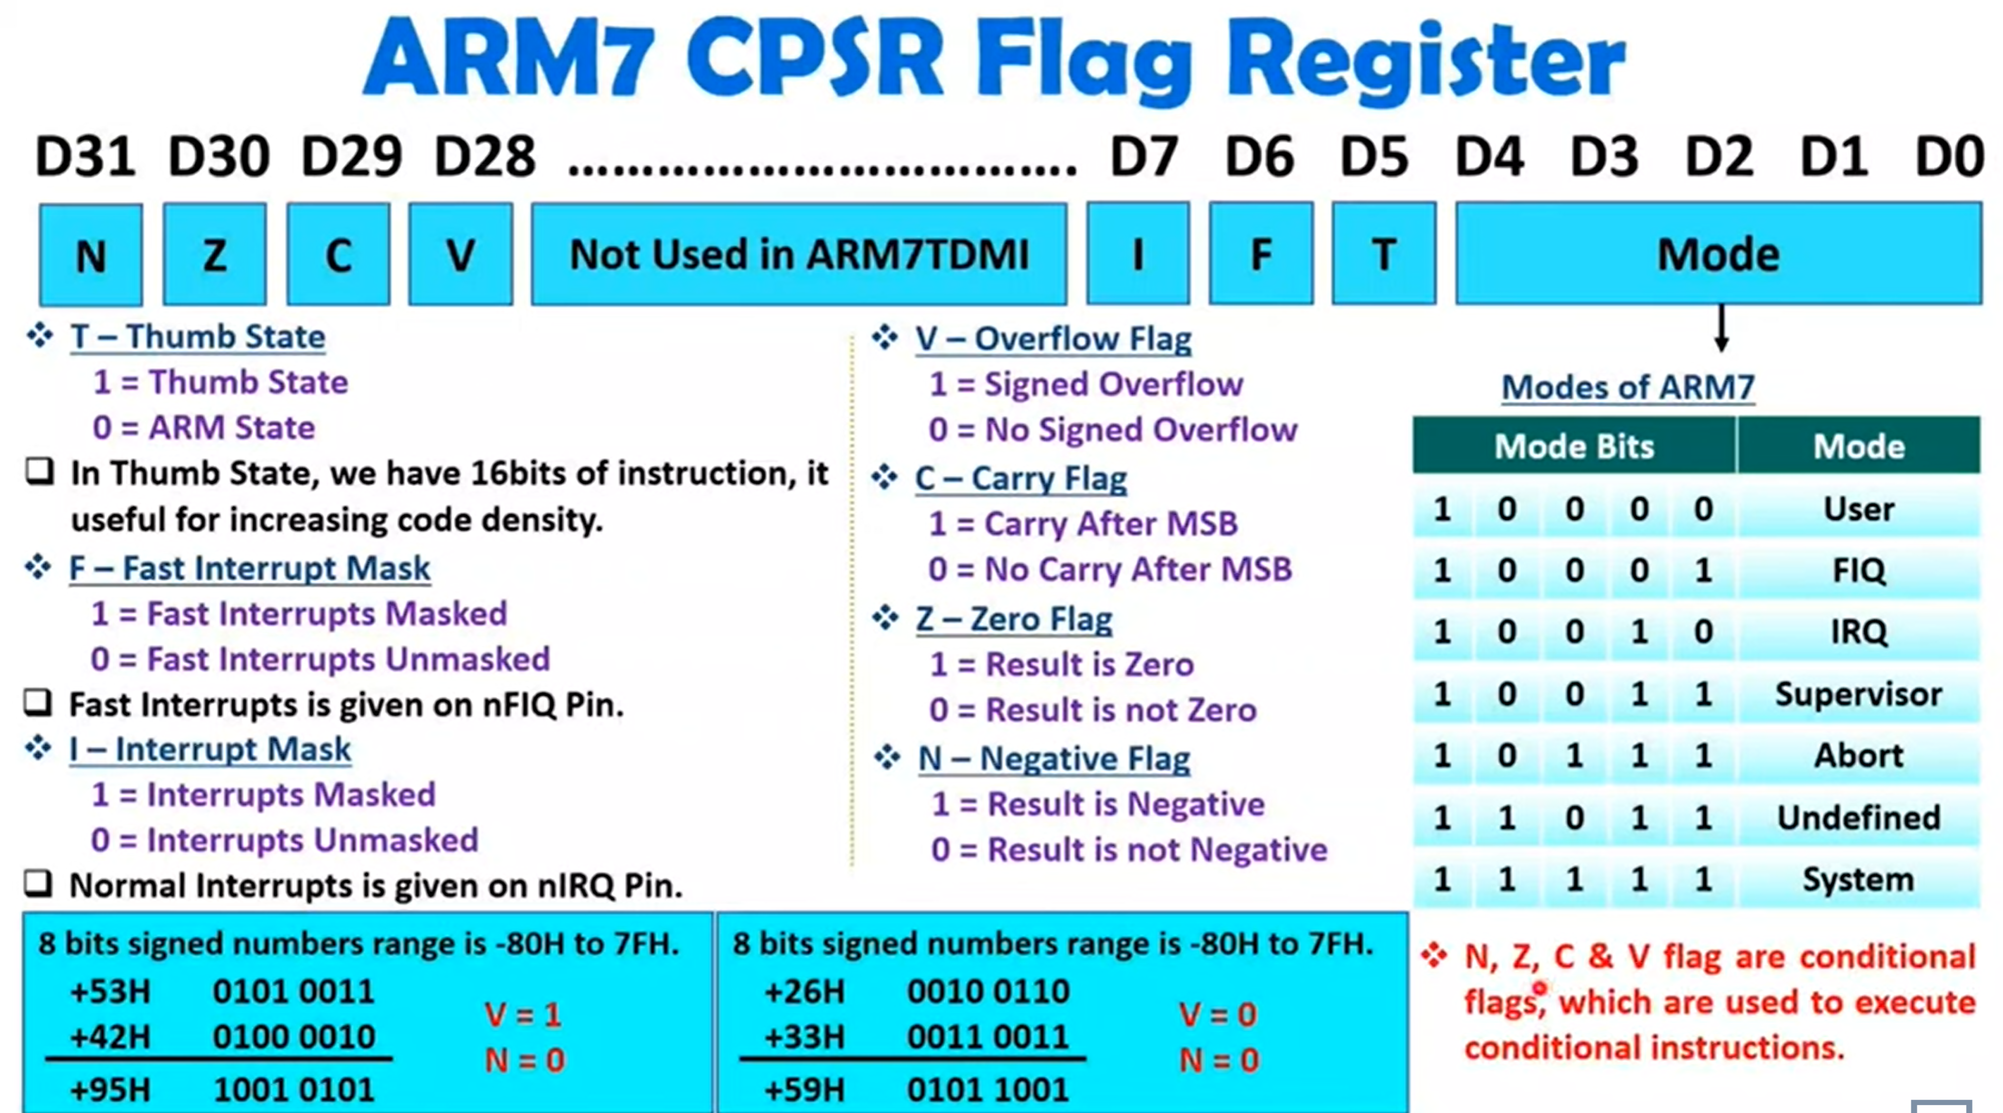

Slide 36
Program Counter (r15)
When the processor is executing in ARM state:
All instructions are 32 bits wide
All instructions must be word aligned
Therefore the pc value is stored in bits [31:2] with bits [1:0] undefined (as instruction cannot be halfword or byte aligned).
When the processor is executing in Thumb state:
All instructions are 16 bits wide
All instructions must be halfword aligned
Therefore the pc value is stored in bits [31:1] with bit [0] undefined (as instruction cannot be byte aligned).
When the processor is executing in Jazelle state:
All instructions are 8 bits wide
Processor performs a word access to read 4 instructions at once
Notes:
ARM is designed to efficiently access memory using a single memory access cycle. So word accesses must be on a word address boundary, halfword accesses must be on a halfword address boundary. This includes instruction fetches.
Point out that strictly, the bottom bits of the PC simply do not exist within the ARM core - hence they are ‘undefined’. Memory system must ignore these for instruction fetches.
In Jazelle state, the processor doesn’t perform 8-bit fetches from memory. Instead it does aligned 32-bit fetches (4-byte prefetching) which is more efficient. Note we don’t mention the PC in Jazelle state because the ‘Jazelle PC’ is actually stored in r14 - this is technical detail that is not relevant as it is completely hidden by the Jazelle support code.

Slide 37
Exception Handling
When an exception occurs, the ARM:
Copies CPSR into SPSR_<mode>
Sets appropriate CPSR bits
Change to ARM state
Change to exception mode
Disable interrupts (if appropriate)
Stores the return address in LR_<mode>
Sets PC to vector address
To return, exception handler needs to:
Restore CPSR from SPSR_<mode>
Restore PC from LR_<mode>
This can only be done in ARM state.
0x1C
FIQ
0x18
IRQ
0x14
(Reserved)
0x10
Data Abort
0x0C
Prefetch Abort
0x08
Software Interrupt
0x04
Undefined Instruction
0x00
Reset
Vector Table
Vector table can be at 0xFFFF0000 on ARM720T and on ARM9/10 family devices
Notes:
Exception handling on the ARM is controlled through the use of an area of memory called the vector table. This lives (normally) at the bottom of the memory map from 0x0 to 0x1c. Within this table one word is allocated to each of the various exception types.
This word will contain some form of ARM instruction that should perform a branch. It does not contain an address.
Reset - executed on power on
Undef - when an invalid instruction reaches the execute stage of the pipeline
SWI - when a software interrupt instruction is executed
Prefetch - when an instruction is fetched from memory that is invalid for some reason, if it reaches the execute stage then this exception is taken
Data - if a load/store instruction tries to access an invalid memory location, then this exception is taken
IRQ - normal interrupt
FIQ - fast interrupt
When one of these exceptions is taken, the ARM goes through a low-overhead sequence of actions in order to invoke the appropriate exception handler. The current instruction is always allowed to complete (except in case of Reset).
IRQ is disabled on entry to all exceptions; FIQ is also disabled on entry to Reset and FIQ.

Slide 38
PIPELINING

Slide 39
Pipelining Stages
Processors can vary in the number of pipeline stages
Often some combination or extension of the following steps
Fetch instructions from memory
Decode the instruction
Execute the instruction or calculate an address
Access an operand in data memory
Write the result into a register

Slide 40
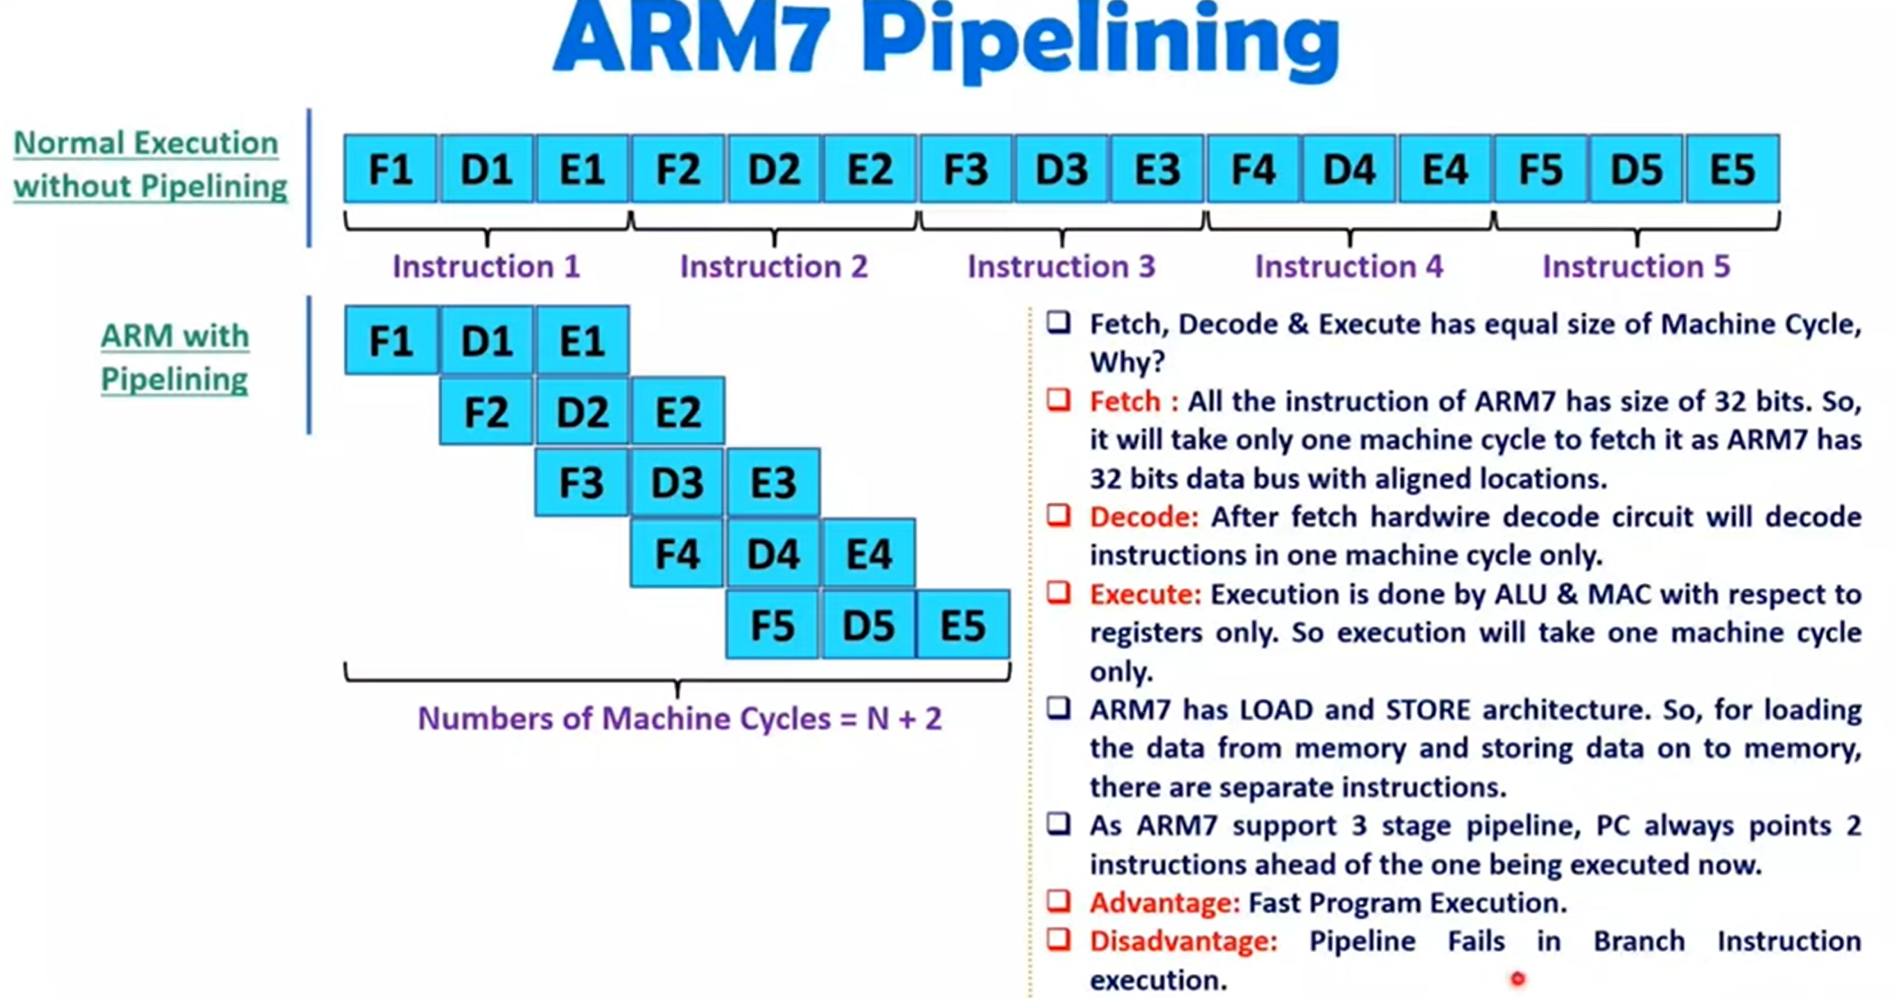

Slide 41
Issues in Pipelining
Length of the pipeline depends on the length of the longest step
Pipeline rate limited by slowest pipeline stage
Because RISC instructions are simpler than CISC, they lend themselves better to pipelining
RISC instructions are often the same length and can be fetched in one operation (ideally in 1 clock cycle)
OK, nothing is ever that simple or ideal
Data dependencies: Instruction depends on the output value of a previous instruction; value might not yet be ready because that previous instruction is also somewhere (although ahead of the current one) in the pipeline
Branch instructions: Next instruction to be executed is decided based on the result of executing another instruction; branch can be conditional on an instruction that has not started execution
Pipeline is stalled; empty instructions (bubbles) inserted into the pipeline

Slide 42
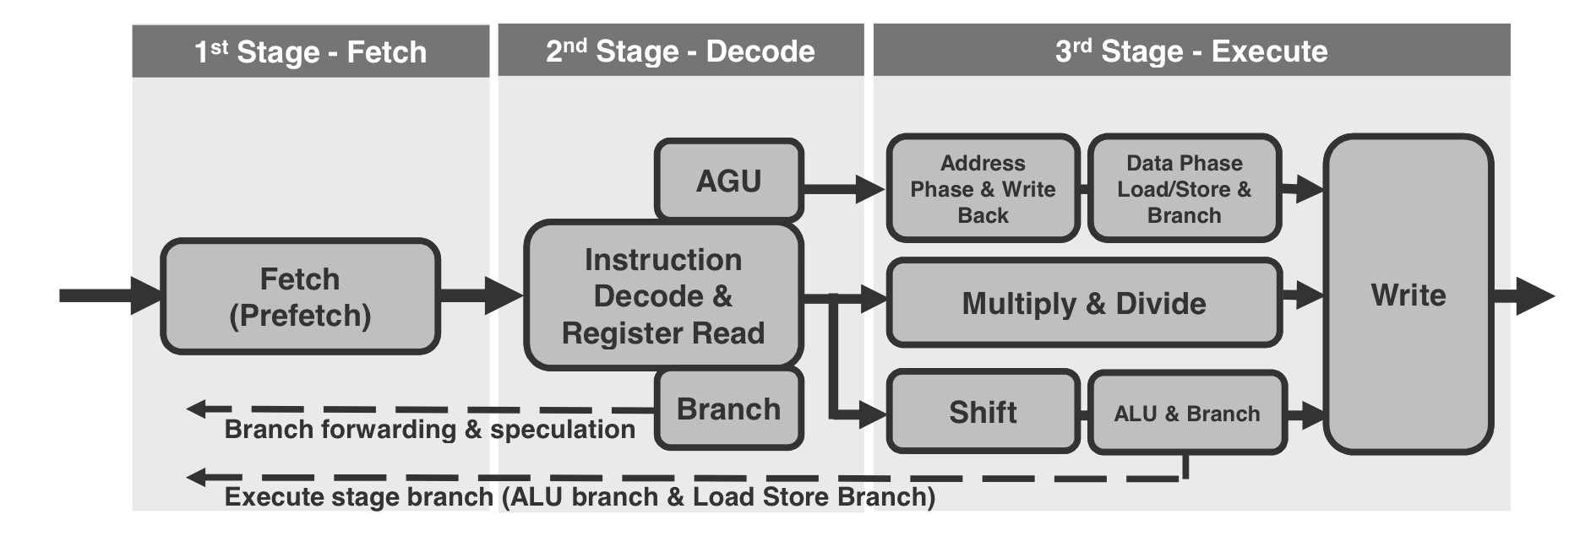
Instruction Cycle
The Cortex M3/M4 has a three-stage pipeline instruction cycle compose of:
Fetch
Decode
Execute

Slide 43
The Fetch Cycle
Program Counter (PC)
Holds address of next instruction that the processor should fetch
So, what happens?
Processor fetches instruction from the memory location that the PC points to
Processor then increments PC
Unless specified otherwise
Sometimes, an offset added depending on processor architecture
Instruction loaded into Instruction Register (IR)
Processor interprets instruction and performs required actions
35

Slide 44
The Decode Cycle
Instructions are decoded - the processor reads the value in the instruction register and understands that it is an add instruction.
Register values are read and readied to be put into the ALU.
Once the registers are read, the processor can also determine the outcome of a branch.

Slide 45
The Execute Cycle
Processor-memory interactions
Data transferred between CPU and main memory
Processor-I/O interactions
Data transferred between CPU and I/O device
Data processing
Some arithmetic or logical operation performed on data
Control action
Change sequence of operations
Example: Branch to subroutine
Combination of the above
37

Slide 46
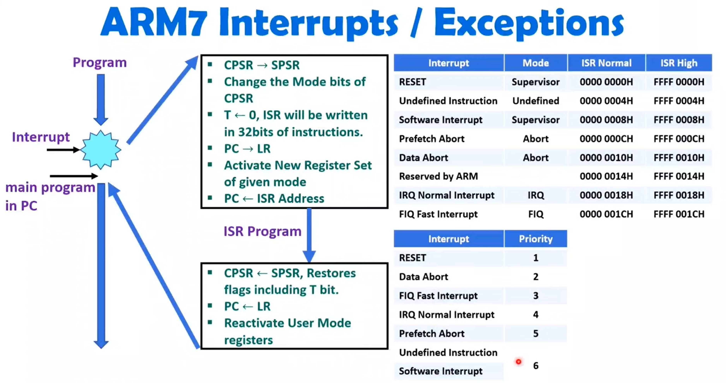

Slide 47
Summary
What is an ARM?
CISC vs RISC
ARM family
Memory
ARM Architecture from a programmer’s viewpoint
Processor modes
General purpose registers
Special purpose registers
Pipelining
What is it?
Why do we do it?
Next Time: Deeper into ARM ASM

